Slide 1
Problems with REST

Slide 2
Problems with REST
During the years it was found that there are some major
problems with REST:
Fixed Entity Structure
Request-Response Only

Slide 3
Fixed Entity Structure
With REST, the client cannot specify the entity parts it want
to retrieve
The entity returned is set by the backend developer and cannot be modified on a per-query basis

Slide 4
Fixed Entity Structure
The employee entity:
{
“emp_id” : 6683,
“full_name” : “David Jones”, “primary_phone” : “055-555-5555”,
“secondary_phone” : “055-444-4444”, “street_address” : “Fifth Ave. 42”, “city” : “NYC”,
“country” : “USA”,
“email” : “david.j@ourcomp.com”, “birth_date” : “05/05/1995”, “base_salary” : “67903”
}

Slide 5
Fixed Entity Structure
The employee is displayed in two places in the app:
List of employees page
Employee page

Slide 6
Fixed Entity Structure
List of employees:
emp_id | full_name | email_address
6683 | David Jones | david.j@ourcomp.com
9928 | Sarah Smith | sara.s@ourcomp.com
3910 | Meredith Potter | meredith.p@ourcomp.com

Slide 7
Fixed Entity Structure
Employee page:
Employee Id: Full name: Primary phone: City:
Country:
Email:
6683
David Jones 055-555-5555 NYC
USA
david.j@ourcomp.com

Slide 8
Fixed Entity Structure
List of employee page:
3 fields
Employee page:
6 fields

Slide 9
Fixed Entity Structure
With REST there’s no way to retrieve only the fields we need
Increases load time and network latency
Sometimes forces to create specialized entity types just for specific queries
Bad for maintenance and data model

Slide 10
Request-Response Only
REST supports only the
Request-Response pattern
Request:
/api/v1/orders/17
Response:
{“orde_date”:”2022-07-
10”,...}
REST API
Service

Slide 11

Request-Response Only
Modern web apps require more types of client-server communication

Slide 12
Request-Response Only
Push notifications are
becoming extremely useful
Request:
/api/v1/orders/17
Response:
{“orde_date”:”2022-07-
10”,...}
REST API
Service

Slide 13
Request-Response Only
Push notifications are
becoming extremely useful
Notification:
{“push_date”:”2022-07-
10”,...}
Service

Slide 14
Request-Response Only
Can be implemented using:
Polling
Web Sockets
Not part of the protocol
Notification:
{“push_date”:”2022-07-
10”,...}
Complex
Service

Slide 15
History of GraphQL
Facebook developed GraphQL as a replacement of REST API for
internal use
First used in 2012
Specification was open sourced in 2015
Currently managed by the GraphQL Foundation

Slide 16
GraphQL Basics
A specification
GraphQL is:
Defines structure of data
returned
JSON-based
3 types of operations
Schema-based
Cross-platform

Slide 17
GraphQL Basics
A Specification
GraphQL defines the semantics and components of a GraphQL API
Does not provide concrete implementations
Other parties develop implementations in many languages
Full specs can be found here:
https://github.com/graphql/graphql-spec

Slide 18
GraphQL Basics
Defines structure of data returned
Perhaps the most important feature of GraphQL
Can specify the part(s) of entity to return
Can specify related entities to be returned
Can specify filtering in the query

Slide 19
GraphQL Basics
JSON Based
Extensive usage of JSON
Query sent to server in JSON
Data is returned in JSON
Technically can be used with other protocols, nobody does this

Slide 20


GraphQL Basics
3 types of operations
With GraphQL we can:
Retrieve Data
Write / Change Data
Subscribe to Changes in Data

Slide 21

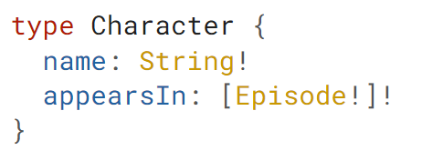
GraphQL Basics
Schema-based
GraphQL works with schema
Defines the entities, fields and attributes
Operations are built on the schema

Slide 22
GraphQL Basics
Cross-platform
Client and server can be based on different platforms
Many implementations in many platforms

Slide 23
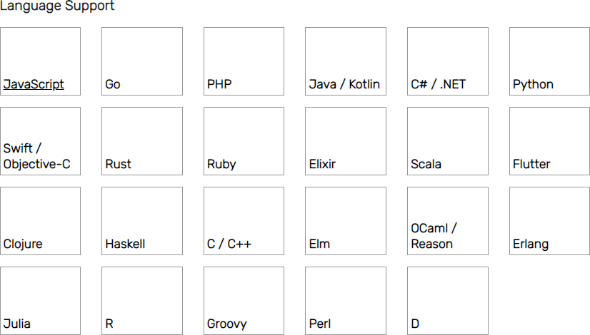
GraphQL Basics
Cross-platform
Up-to-date language support list: https://graphql.org/code/#language-support

Slide 24
Working with GraphQL
Four main steps:
Defining Schema
Defining Queries
Defining Mutations and Subscriptions (optional)
Implementing the Logic

